Slide 1
Cied infections
Dr MOHAMMED AKMAL HAQ K P

Slide 2
REFERENCES
BRAUNWALD TEXTBOOK OF CARDIOLOGY
HURST TEXTBOOK OF CARDIOLOGY
EUROPEAN HEART RHYTHM ASSOCIATION (EHRA)INTERNATIONAL CONSENSUS DOCUMENT ON HOW TOPREVENT, DIAGNOSE, AND TREAT CARDIACIMPLANTABLE ELECTRONIC DEVICE INFECTIONS
UPTODATE – EVIDENCE BASED CLINICAL DECISION SUPPORT

Slide 3
CIED INFECTIONS
CIEDS : OVER THE PAST 60 YEARS : IMPORTANT THERAPEUTIC MODAILITY OF CARDIOVASCULAR DEVICES
Traditionally include : PPI ICDS CRT
Generally considered into two categories : POCKET INFECTIONS AND SYSTEMIC INFECTIONS
ALTERNATIVE CLASSIFICATION : Primary VS Secondary
Notes:
With the increasing use of CIED FOR VARIOUS CONDITONS LIKE BRADYCARDIA, HEART FAILURE TACHYARRYTHMIAS → CIED INFECTIONS HAS BECOME INCREASINGLY PREVALENTS
The clinical presentation and management of CIED INFECTIONS VARY ACCORDING TO THE : LOCATION , EXTENT OF INFECTION PATIENT CHARACTERSTICS
Device-related in-fection is, however one of the most serious complications of cardiac implantable electronic device (CIED) therapy associated with significant morbidity, mortality, and financial healthcare bur-den

Slide 4
DENMARK : Incidence of infection was studied 98000 patients : implantation and replacement procedures
BETWEEN 1982 AND 2018
P P I | 1.2 PERCENT LIFETIME RISK
I C D | 1.9 PERCENT LIFETIME RISK
CRT P | 2.2 PERCENT LIFETIME RISK
CRT D | 3.4 PERCENT LIFETIME RISK
Notes:
True incidence of CIED INFECTIONS is difficult to determine due to lack of comprehensive registery → range of values form various observational series→
Incidenc rate wre lowest during the intial implantation and 1.5 to 3 times higher revision or replacement

Slide 5
UNITED STATES NATIONAL INPATIENT SAMPLE
OVERALL INFECTION INCIDENCE [ 1993-2006] | 1.6%
ANNUAL INCIDENCE OF CIED INFECTION [2004-2012] | 2.06%
ANNUAL PROPORTION OF CIED RELATED IE [2006-2018] | 1.7 TO 4.8%
Notes:
LARGEST PUBLICALLY AVAILABLE PATIENT CARE DATA BASE IN US

Slide 6
RISK FACTORS
A number of risk factors and comorbid conditons have been associated with CIED infections
Most clearly identified : recent manipulation of the device
R/F : Number of prior procedures , lack of Antibiotic prophylaxis at the time of implantation , immunocompromised state, renal dysfunction postprocedure hematoma.
SYSTEMATIC REVIEW : 3 MAJOR CATEGORIES OF RISK FACTOR

Slide 7
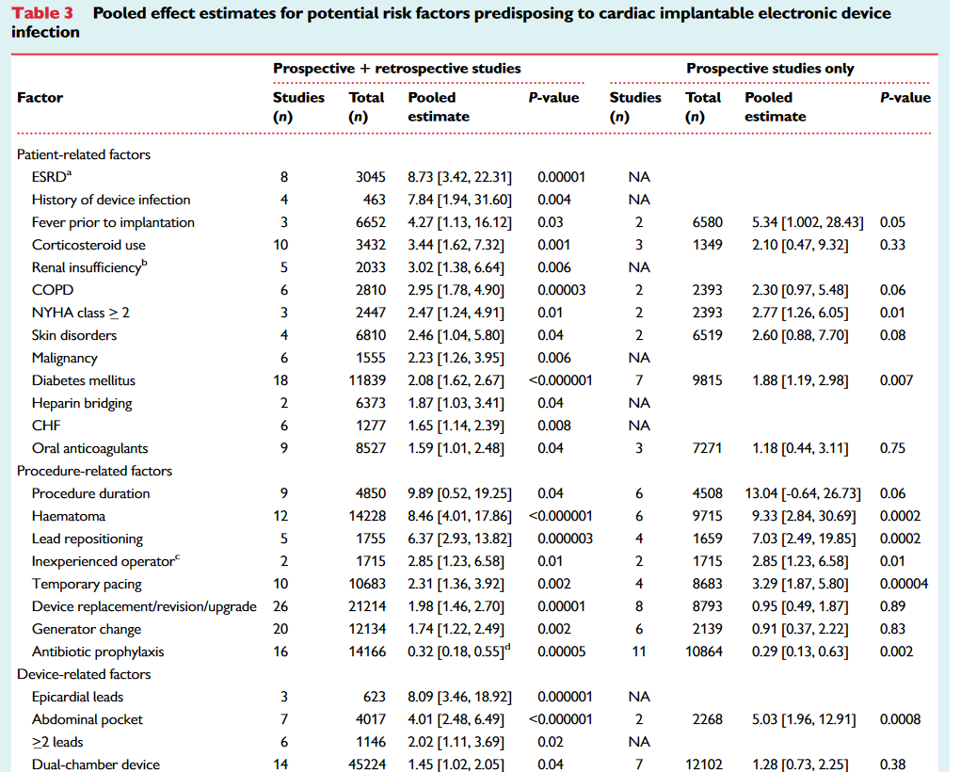
Notes:
These risk factors may b modifiable or non modfifiable.
Identifiable of modifiable risk factor → they may allow for preventive measures.
Antibiotic prophylaxis was a/w 70% RRR →
The prsesnce of hematoma was a/w → 9 fold increased risk of infection → bruise control study
Early reoperation for hematoma or lead dislodgement → strongest R/F →
Procedure duration → was a/w multifold increased risk of infection
Device generator replacement roughly doubles the risk of infection

Slide 8
MICROBIOLOGY
STAPHYLOCOCCUS
STREPTOCOCCUS ENTEROCOCCUS
CORYNEBACTERIUM CUTIBACTERIUM
GRAM NEGATIVE BACTERIA
CANDIDIASIS
Notes:
STAPH AND CoNS CAUSE THE MAJORITY OF GENERATOR POCKET INF AND UPTO 90%DEVICE RELATED INF ENDOCARDITIS

Slide 9
600 cied infections : only 5% : gram negative infection → predominantly pocket infection → psuedomonas & serratia
Another study : 412 cied infections : mc organism isolated : staphylococcus
Four studies : pacemaker endocarditis
COAGULASE NEGATIVE STAPHYLOCOCCUS | 60%
STAPHYLOCOCCUS AUREUS | 30%
POLYMYCROBIAL INFECTION | 1%
CULTURE NEGATIVE | 8%
Notes:
THESE DATAS HAVE BEEN OBTAINED FORM DIFFERENT STUDIES . . .
STAPHYLOCOCCUS → OF WHICH 60% OF INF LOCALISED WAS POCKET INF AND 40% WERE ENDOVASCULAR INFLAMMATION WITHOUT POCKET INFLAMMATION

Slide 10
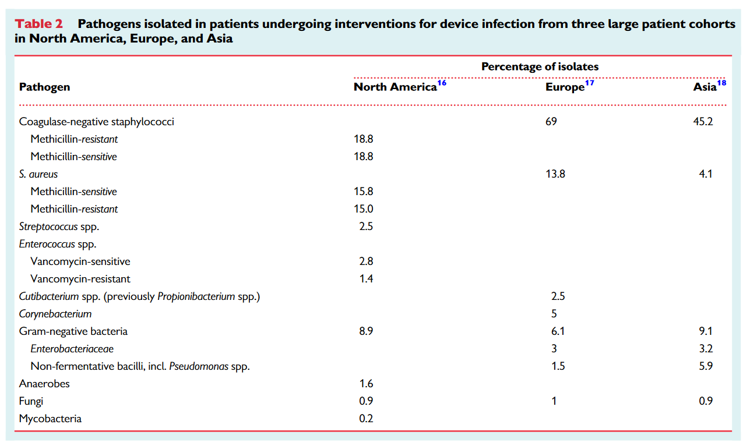

Slide 11
S. AUREUS BACTEREMIA :
HIGH RATE OF CIED INFECTION
HIGH MORTALITY
CONCURRENT VALVULAR INFECTION
RISK OF RELAPSE WAS GREATER WITH STAPH AUREUS BACTEREMIA
SECONDARY BACTEREMIC SEEDING OF STAPH AUREUS INFECTION .
Notes:
HIGH MORTALITY→ IT IS LIKELY THAT MANY OF THESE PATIENTS HAVE PRIMARY INFECTIONS OF THE CIED PARTICULARLY WHEN BACTEREMIA OCCURS LESS THAN 3 MONTHS
SECONDARY BACTEREMIC SEEDING OF THE CIED FROM STAPHYLOCOCCUS FROM REMOTE SITE. .

Slide 12
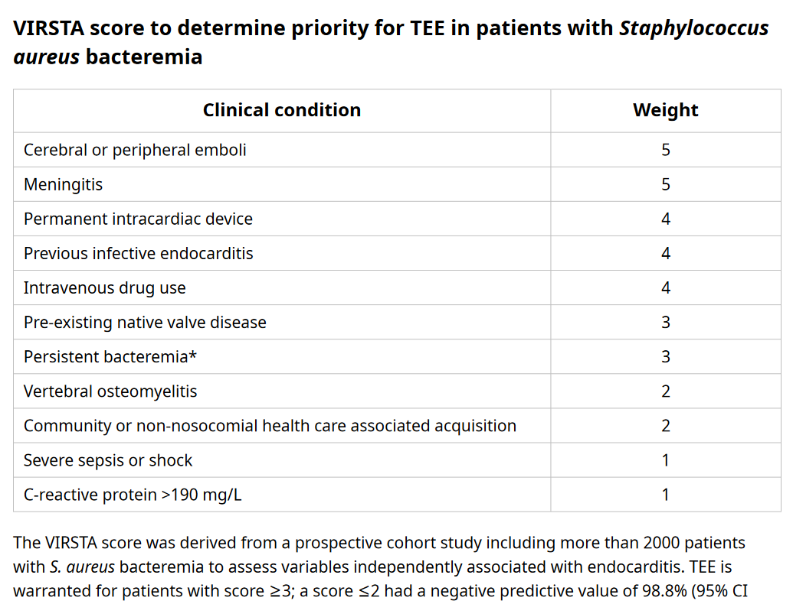
Notes:
PREDICTION SCORE TO ESTIMATE THE RISK OF IE

Slide 13
FUNGEMIA
Datas : sparse
Systematic rview of case reports & case series : 90% are a/w valve or lead involvement
Most of the patients : immunocompromised & chronically ill
Cied extraction was associated with increased survival to hospital discharge
[ 92% vs 52% ]
Notes:
1. Datas on fungemia in patients with cied are sparse.
2. 90% of fungemia were a/w →
3. Hospital discharge → among cases wer device wer removed vs retained

Slide 14
FORMS OF INFECTIONS
CIED POCKET INFECTIONS
INVOLVING : SUBCUTANEOUS POCKET & SUBCUTANEOUS SEGMENT OF LEADS
GENERALLY HAVE : NEGATIVE BLOOD CULTURE & NO E/O LEAD OR VALVE VEGETATION
SYSTEMIC INFECTION
EXTENSION OF CIED POCKET INFECTION TO INVOL;VE INTRAVASCULAR LEADS
CONCURRENT POSITIVE BLOOD CULTURE AND /OR EVIDENCE OF A LEAD / VALVE VEGETATIONS ON TEE

Slide 15
CIED POCKET INFECTION
Mc source : perioperative contamination with skin flora
Present : acute or delayed onset infection
Ppi study : swab specimen from pocket before and after genetor insertion [ 50% vs 37% ]
Subsequent ppi infection : 4.8% patients → 3 of the infections later
Organism : predominantly cons
Notes:
DELAYED → DEMONSTRATED IN A PROSPECTIVE STUDY IN PATIENTS UNDERGOING PACEMAKER. .
BASED ON MOLECULAR TYPING → ISOLATES RECOVERED AT INSERTION AND AT THE TIME OF THE INFECTION WERE IDENTICAL

Slide 16
CIED POCKET INFECTION
Typically develops : soon after cied implantation
Can also arise many months later → chronic smoldering infections
Acute or subacute pocket ifection
Pocket discomfort , erythema of skin , swelling drainage through dehisced incision
Fever and systemic symptoms are often absent
Patients with evident pocket infection → sirs → at risk for bacteremia
Notes:
***INFECTIONS INVOLVING GENERATOR POCKET . . . →
***SMOLDERING → BOTH THE CASES CONTAMINATION OCCUR AT THE TIME OF IMPLANATION

Slide 17
CIED POCKET INFECTION DIFFERENTIALS
EARLY SUPERFICIAL INFECTION | EARLY POSTIMPLANTATION INFLAMMATION | POCKET HEMATOMA
INCLUDES : SUPERFICIAL STITCH ABSCESS OCCURS WITHIN 30 DAYS OF IMPLANTATION | VERY RARE EVENT OCCURS WITHIN INTIAL 30 DAYS OF IMPLANTATION | BLOOD COLLECTION WITHIN THE POCKET / COLLECTING IN SUBPECTORAL SPACE
LOCALISED TO SUPERFICIAL ASPECT OF WOUND | ERYTHEMA OF SKIN ABUTTING THE INCISION | OCCURS WITHIN FIRST 24 HOURS SWELLING & MINIMAL SKIN DISCOLOURATION
DOESNOT EXTEND TO INVOLVE POCKET | NO PURULENT EXUDATE , DEHISENCE, FLUCTANCE OR SIRS RESOLVES → WITHIN 2 WEEKS | CAN PREDISPOSE TO INFECTION
Notes:
The diagnosis of pocket infection shud be suspected wen ther is inflammation overlying implanted device. . .
POCKET INFECTION MUST BE DISTINGUISHED FROM. . . .
IN THE ABSENCE OF STITCH ABSCEES → DIFFICULT TO DISTINGUISH FROM EARLY POSTIMPLANTATION INFLAMMATION.

Slide 18
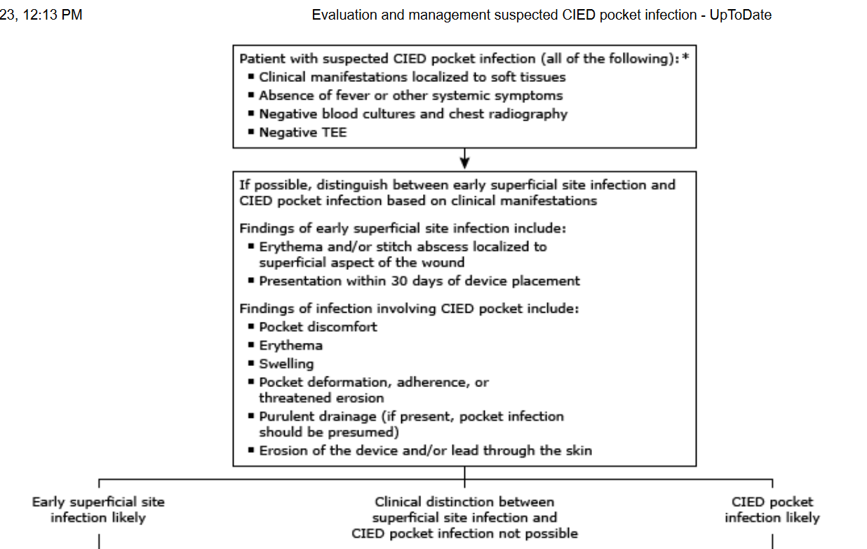

Slide 19
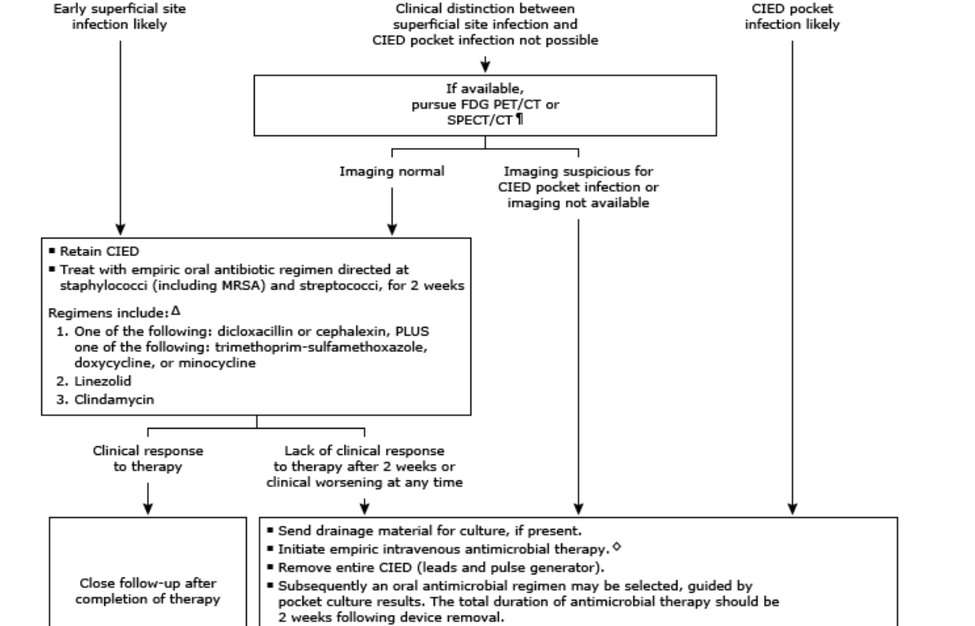

Slide 21
CIED POCKET INFECTIONS
IN THE ABSENCE OF CLINICAL SIGNS OF INFLAMMATION → PERCUTANEOUS ASPIRATION IS NOT WARRANTED
IN THE SETTING OF PRIOR ANTIMICROBIAL THERAPY : POCKET INFECTION MAY BE OBVIOUS CLINICALLY → POCKET & BLOOD CULTURE MAY BE NEGATIVE
IN THE ABSENCE OF PRIOR ANTIBIOTIC THERAPY : NEGATIVE GRAM STAIN OR CULTURE MAY INDICATE INFECTION → UNUSUAL ORGANISM
Notes:
Not warranted → as the diagnostic yield is low and potential risk of introducing microorganism.
PATIENT WITH OVERT POCKET INFECTION → DRAINING PURULENT FLUID SHUD BE CULTURES + BLOOD CULTURE SHUD BE DRAWN ATLEAST 2 OR 3 SETS → EMPIRIC ANTIBIOTIC THERAPY SHUD BE STARTED.

Slide 22
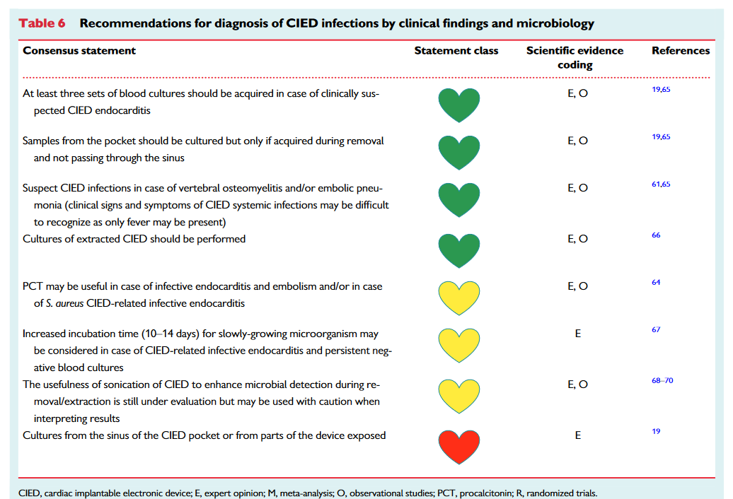
Notes:
3 SETS OF BLD CULTURES SHOULD BE TAKEN ATLEAST 30 MINS IN BETWWEN
2. SWABS COLLECTED FROM CHRONIC DRAINING SINUS OR FISTULA ARE DISCOURAGED ,INSTEAD TISSUE OR FLUID COLLECTED FROM THE POCKET SHOULD BE ENCOURAGED
3. DURING EXTRACTION PROCEDURE DISTAL AND PROXIMAL LEADS AND GENERATD POCKET TISSUE SHOULD BE SENT FOR CULTURE
4.

Slide 23
CIED SYSTEMIC INFECTION
Infection : involving transvenous portion of the lead with involvement of the contigous endocardium or tricuspid valve or an epicardial electrode
Can occur : with or without involvement of generator pocket
Generally → positive blood culture and/or vegetation on lead
Notes:
*** PATIENTS WITH CIED SYSTEMIC INFECTION →
*** SYNONYMS OF CIED SYSTEMIC INFECTION → LEAD INFECTION AND DEVICE RELATED IE

Slide 24
INTRACARDIAC PORTION OF LEAD → RA , TV & RV CONTACT POINT
INFECTIONS MAY TRACK INTRAVASCULARLY ALONG THE DEVICE LEAD FROM SC POCKET OR BACTEREMIC SEEDING
HOST RESPONSE TO PLACEMENT OF LEAD CAN PROVIDE PROTECTION FROM LATE BACTERIAL SEEDING
~ 1 WEEK AFTER PLACEMENT → PORTION OF LEAD IN CONTACT WITH VEIN INTIMA → INCORPORATED
ENDOTHELIAL COVERING MAY PROTECT THE LEADS AGAINST THE ADHERENCE OF BACTERIA → SUBSEQUENT INFECTION → BACTEREMIA
Notes:
INFECTION OF THE INTRAVASCULAR COMPONENT OF CIED SYSTEM OCCURS PRIMARILY →
OCASSIONALLY VEGETATIONS MAY BE SEEN ON THE LEAD AS IT TRAVERSE FROM SVC TO RA
ENDOCARDITIS LIKE VEGETATION OCCUR PREIMARILY ON →
SEEDING OF THE CIED FROM BACTEREMIA. PRIMARILY INVOLVE INTRACARDIAC LEAD.

Slide 25
CIED SYSTEMIC INFECTION
Can manifest → lead vegetation and/or adjacent valave vegetation
Device related I E
1. Presence of vegetation attached to the device lead
2. Primarily involve intracardiac portion of the lead
Upto 50% of patients with cied I E → echocardiographic or intraoperative evidence of vegetation on valve
Notes:
*** ENDOCARDITIS IS AN IMPORTANT FEATURE OF CIED SYSTEMIC INFECTION.
OCASSIONALLY → ECHO DEMONSTRATES ISOLATED LEFT SIDED IE OR FAILS TO DEMONSTRATE A VEGETATION IN CIED LEAD INFCTION & BACTEREMIA

Slide 26
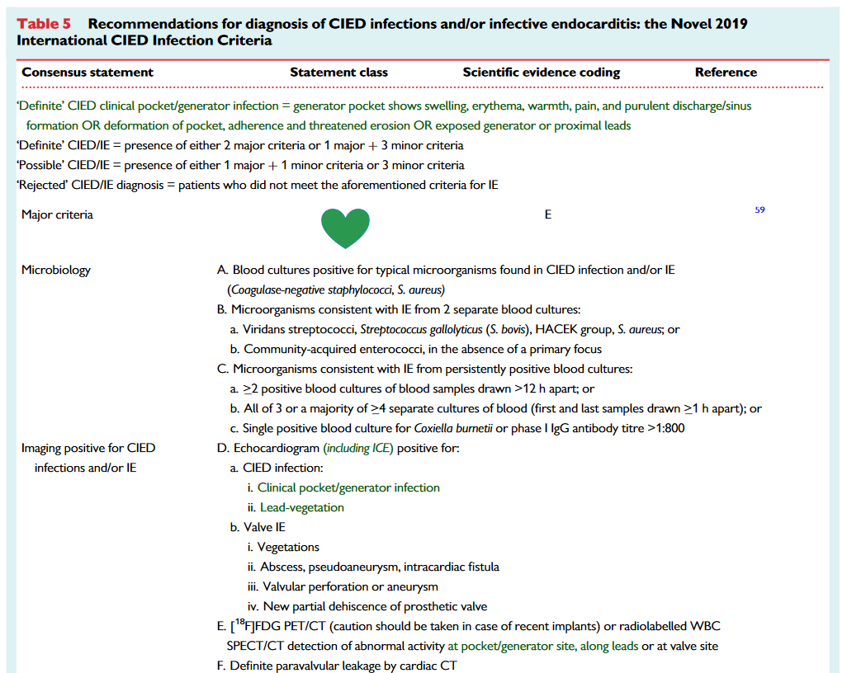
Notes:
THERE IS NO STANDARDISED CRITERIA TOOL FOR CIED ENDOCARDITIS

Slide 28
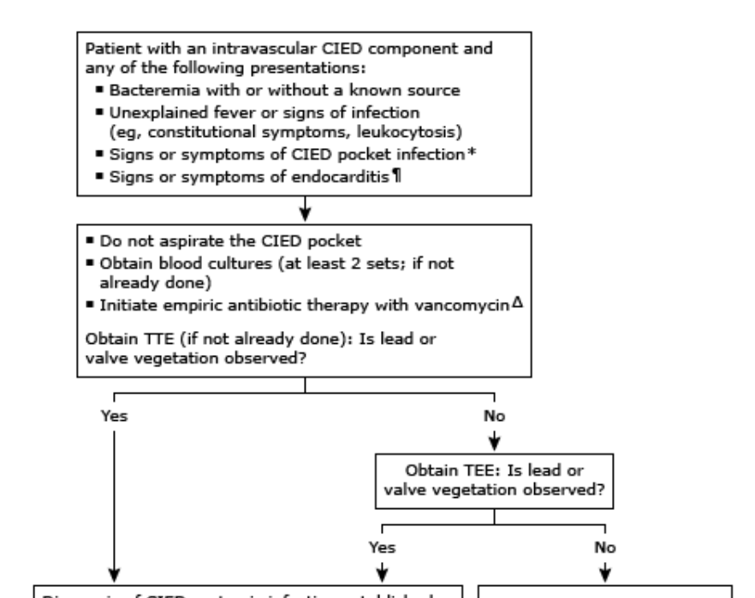

Slide 29
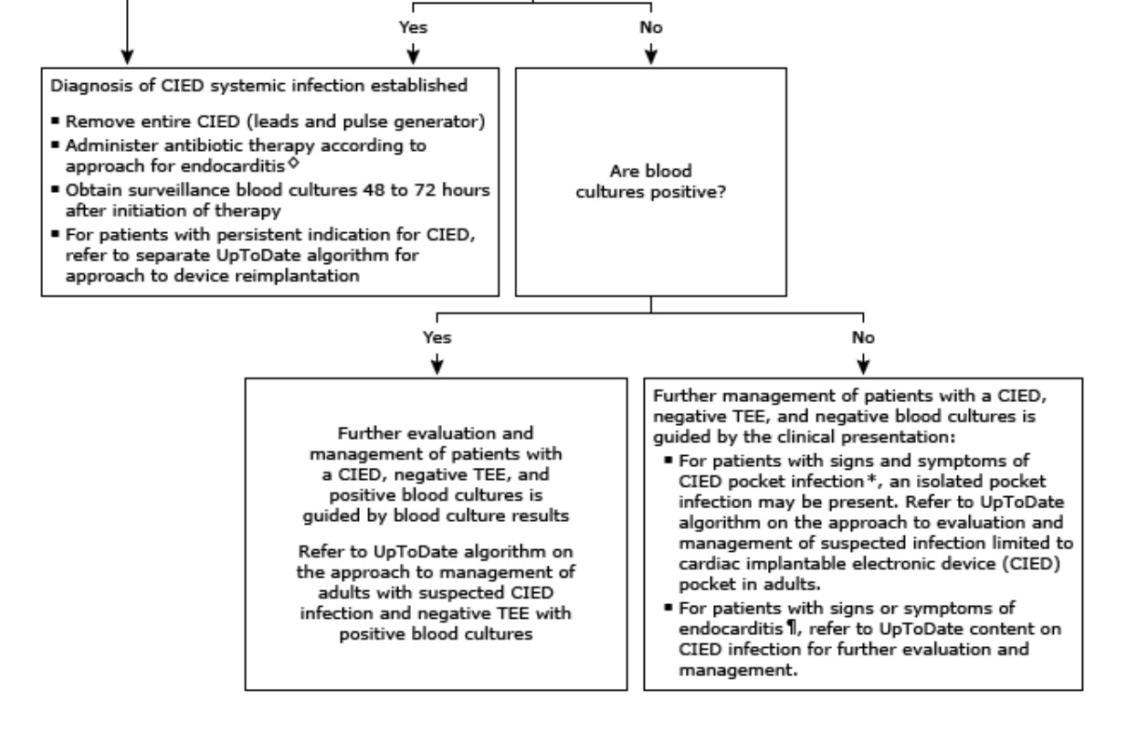

Slide 30
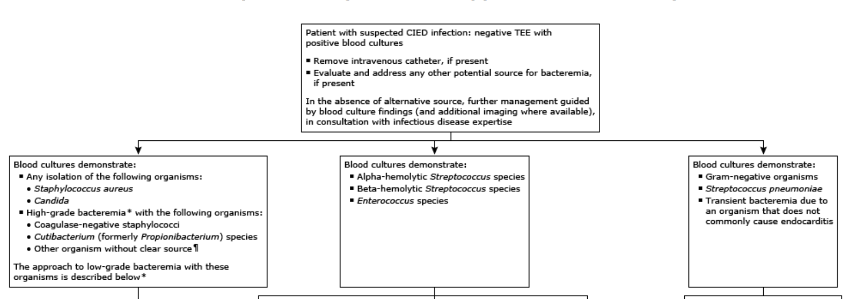

Slide 31
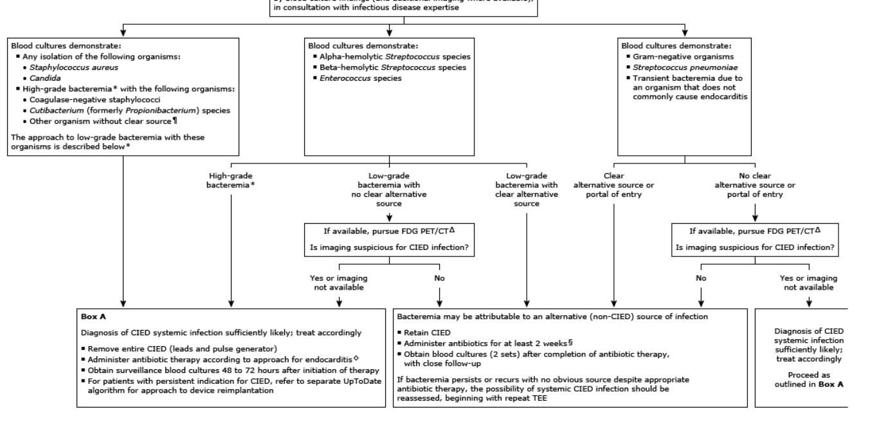

Slide 32
Notes:
FIRST IMAGING TOOL → TTE
ISSUE HERE IS → IN THE ABSENCE OF TYPICAL VEGETATION OF MEASURABLE SIZE → TTE & TEE MAY BE FALSE NEGATIV
LEAD MASSES IN ASYMPTOMATIC CIED CARRIERS MAY BE OBSERVED IN TTE / TEE → DONOT PREDICT IE.
FDG PET / WBC SCINTIGRAPHY → ADDITIONAL DIAGNOSTIC VALUE IN POSSIBLE CIED INFECTIONS → DIFFERENTIATE EARLY SUPERFICIAL INFECTION VS DEEP POCKET INFECTION

Slide 33
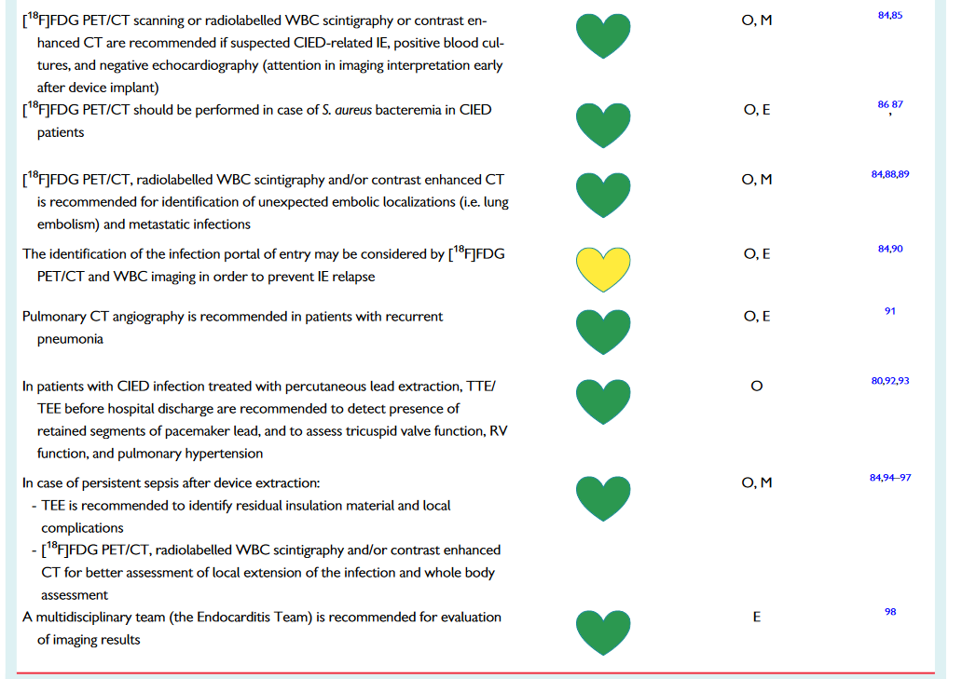
Notes:
FDG PET / WBC SCINTIGRAPHY → ADDITIONAL DIAGNOSTIC VALUE IN POSSIBLE CIED INFECTIONS → DIFFERENTIATE EARLY SUPERFICIAL INFECTION VS DEEP POCKET INFECTION
ANOTHER USEFUL SITUATION WHEN PATIENT PRESENT WITH SYSTEMIC INFECTION WITHOUT LOCAL FINDINGS → FDG PET
ISSUE → AFTER DEVICE IMPLANTATION THERE ARE POST INFLAMMATORY CHANGES THAT MAY APPAER SIMILAR TO THAT OF INFECTION UPTO 6WEEKS → DURING THIS PERIOD → USEFULNESS IS DOUBTFUL
WBC SCINTIGRAPHY → HIGH SENSITIVITY & SPECIFICITY (94% VS 100%)
FDG PET → ABILITY OF WHOLE BODY EVALUATION → PARTICULARLY USEFUL → UNEXPECTED EMBOLISATION AND METASTATIC INFECTIIONS

Slide 34
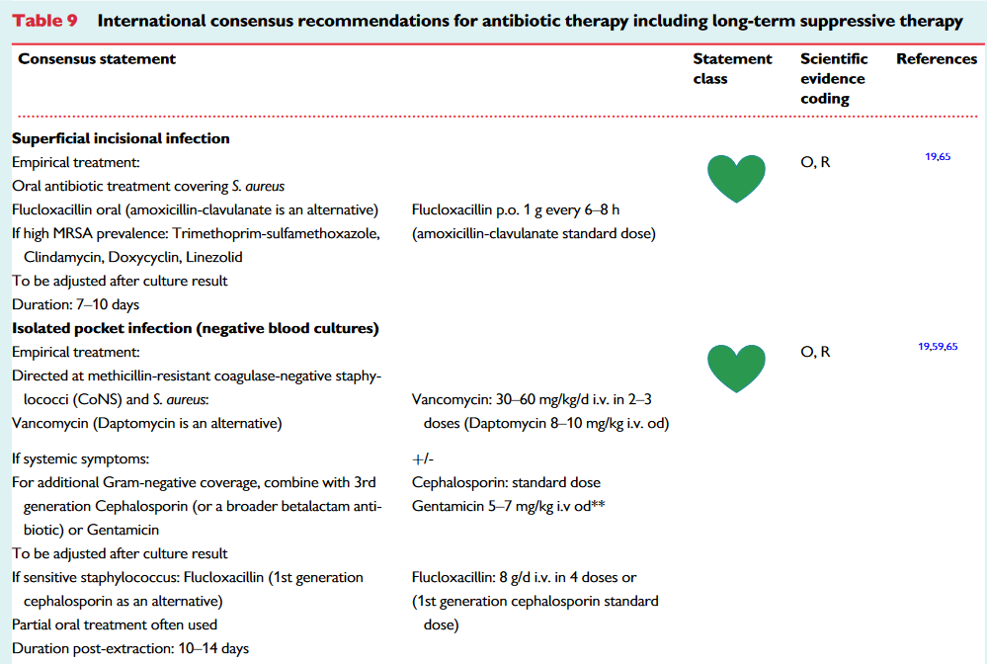

Slide 35
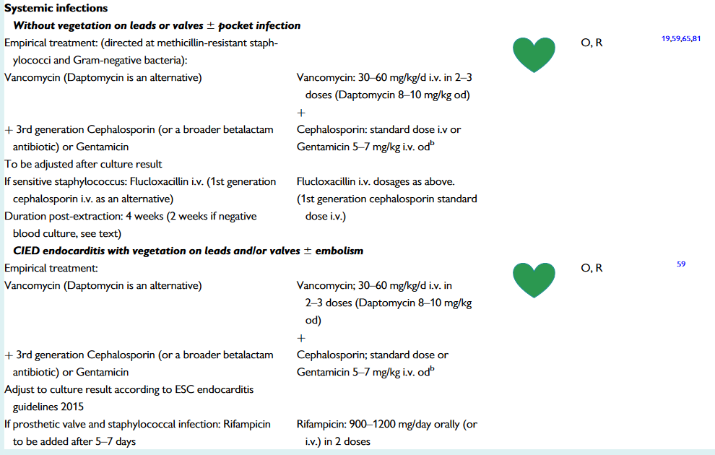

Slide 36
PREVENTION
PREPROCEDURAL MEASURES
PERIPROCEDURAL MEASURES
POSTPROCEDURAL MEASURES

Slide 37
PATIENT SELECTION | CAREFUL CONSIDERATION → RISK VS BENEFIT SIGNIFICANT RISK OF INFECTION DELAY IMPLANTATION AVOIDING TRANS VENOUS SYSTEM AND IMPLANTING EPICARDIAL SYSTEM IN HIGH RISK PATIENTS
LEAD MANAGEMEMENT | NUMBER OF LEADS AND PRESENCE OF ABANDON LEADS→INFECTION
PATIENT FACTORS | PRESENCE OF ACTIVE INFECTION → PROCEDURE DELAYED NEED FOR TEMPORARY PACING → INCREASE RISK OF INFECTION STRICT GLYCEMIC CONTROL PREVENTS INFECTION
APPROPRIATE ENVIRONMENT | OPERATING ROOM AND CATH LAB MUST MEET STANDARD STERILE PROCEDURES
Notes:
D BEST TREATMNT OF DEVICE RELATD INFECTION → PREVENTION.
2. CONSIDERATN → SHUD B GIVEN TO WHETHER → RISK OF DEVIC IMPLNTATION → OUTWEIGHS BENEFIT
3. THE DECISION TO EXTRACT OR ABANDON LEAD IS A COMPLEX DECISION → MAD ON INDIVIDUAL BASIS
BOTH IN OPERATING . . . MINIMUM STANDARDS FOR THE ENVIRONMENT FOR CIED PROCEDURES HAVE BEEN PUBLISHED →
TPI VIA JUGULAR ROUTE MAY PROVIDE A LOWER RISK OF INF THAN GROIN ACCESS { LARGE SCALE STUDIES MNOT AVAILABLE}

Slide 38
ANTICOAGULATION ANTI PLATELET DRUGS | POCKET HEMATOMA → RISK OF INFECTION BRIDGING APPROACH WITH ANTICOAGULATION → NOT RECOMENDED ANTIPLATELETS PREFERABLY DISCONTINUED 5-10 DAYS BEFORE
STAFF TRAINING | ALL STAFF INVOLVED IN CIED IMPLANTATION MUST BE TRAINED IN APPROPRIATE STRICT STERILE TECHNIQUES OPERATORS SHOULD BE ADEQUATELY TRAINED AND SUPERVISED
NASAL SWAB / STAPH AUREUS DECOLONISATION | STAPH AUREUS COLONISATION CAN BE DETECTED BY NASAL SWAB NASAL TREATMENT WITH MUPIROCIN AND CHLORHEXIDINE SKIN WASH
PRE PROCEDURE SKIN PREPARATION | PRE SURGICAL WASHING WITH ANTI MICROBIAL AGENTS →DATA ON THIS PRACTICE FOR GENERAL SURGICAL PROCEDURES IS DIVERSE CHEST HAIR REMOVAL → RAZORS NOT TO BE USED
Notes:
1. IN PATIENTS WHO ARE NOT AT HIGH RISK FOR THROMBO EMBOLIC EVENTS HOLDING ANTI COAGULATION FOR THE PROCEDURE AND RESTARTING WHEN THE BLEEDING IS REDUCED
2. THERAPEUTIC LMWH SHOULD BE AVOIDED
3. FOR ELECTIVE PROCEDURE → S. AUREUS COLONISATION
4. SKIN WASH → CAN REDUCE COLONISATION , HAS BEEN SHOWN IN SOME SURGICAL STUDIES BUT THERE IS NO STUDIES SPECIFICALLY TO CIED INTERVENTION
DIVERSE→RECCOMENDATION FOR ITS ROUTINE USE CANNOT BE STRONGLY SUPPORTED

Slide 39
PRE PROCEDURE ANTIBIOTIC THERAPY
STANDARD OF CARE→ USE OF PROPHYLACTIC SYSTEMIC ANTIBIOTIC→ LOWERS INFECTION RATE
COMPARISON WITH NO ANTIBIOTIC THERAPY→ RRR 40-95 %
ANTIBIOTICS GIVEN 1 HR PRIOR TO INCISION
MC ORGANISM IN CIED INFECTION → STAPH AUREUS
ANTIBIOPTIC THERAPY SHOULD ATLEAST COVER STAPH AUREUS SPECIES
RCT→ IV FLUCLOXACILLIN 1-2 G
FIRST GEN CEPHALOSPORINS → CEFAZOLIN 1-2 G
VANCOMYCIN { ALLERGIC TO CEPHALOSPORIN}
Notes:
SPECIES→CURRENTLY THERE ARE NO SIGNIFICANT DATA TO SUPPRT ROUTINE MRSA COVERAGE → ITS USAGE SHUD B GUIDED BY PREVALENCE OF MRSA IN IMPLANTING INSTITUTION.
ANTIBIOTICS

Slide 40
PERI PROCEDURAL MEASURES
Patient surgical preparation
Good surgical technique
Antibiotic enevelope
Local instillation of envelope
Capsulectomy
Closure

Slide 41
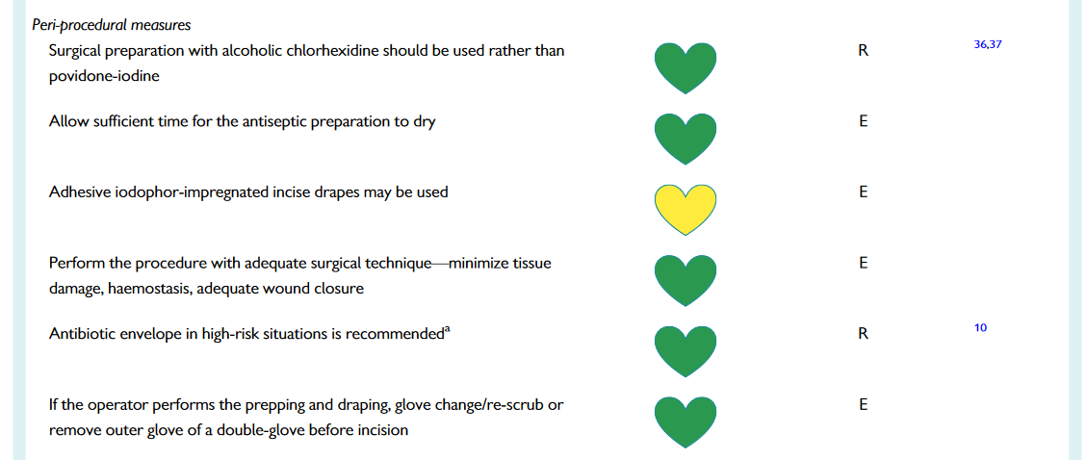
Notes:
1.RCT HAVE DEMONSTRATED ALCOHOLIC 2%CHLORHRXDN TO BE SUPERIOR TO POVIDINE IODINE FOR SKIN PREP PRIOR TO SX
THE ANTISEPTIC→ ALLOWED TO DRY COMPLETELY BEFORE
2 . ANTIBOTIC ENVLP== LOCALLY RELEASES MINOCYCLIUNE AND RIFAMPIN --. MIN OF 7 DAYS TO PREVENT INF AND BIOFILM FORMATION
WRAP –IT TRAIL->

Slide 42
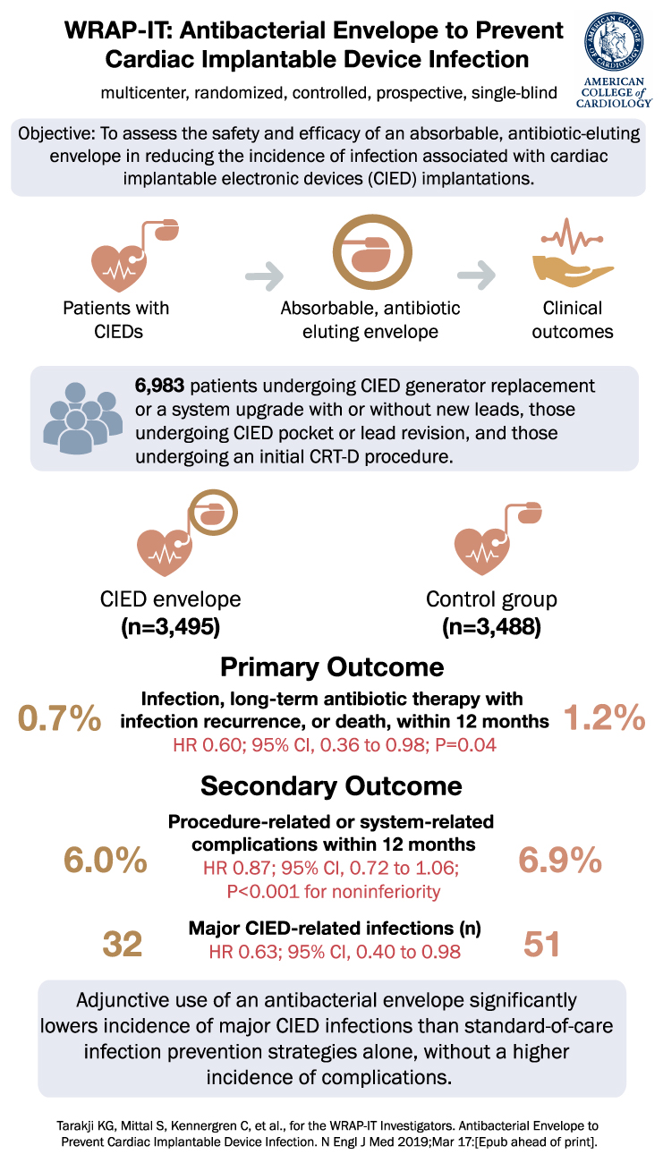
Notes:
POPULATION TREATED SHORT BENEFIT, THE NUMBER OF PATIENTS NEEDED TO RX ONE INFECTION WAS HIGH
THE EXCLUSION OF HIGH RISK PATIENTS MAY HAVE CONTRIBUTED TO LOWER THAN EXPECTED RATE OF INF WHICH IS OBSERVD IN OTHER PROSPECTIVE STUDIES

Slide 43
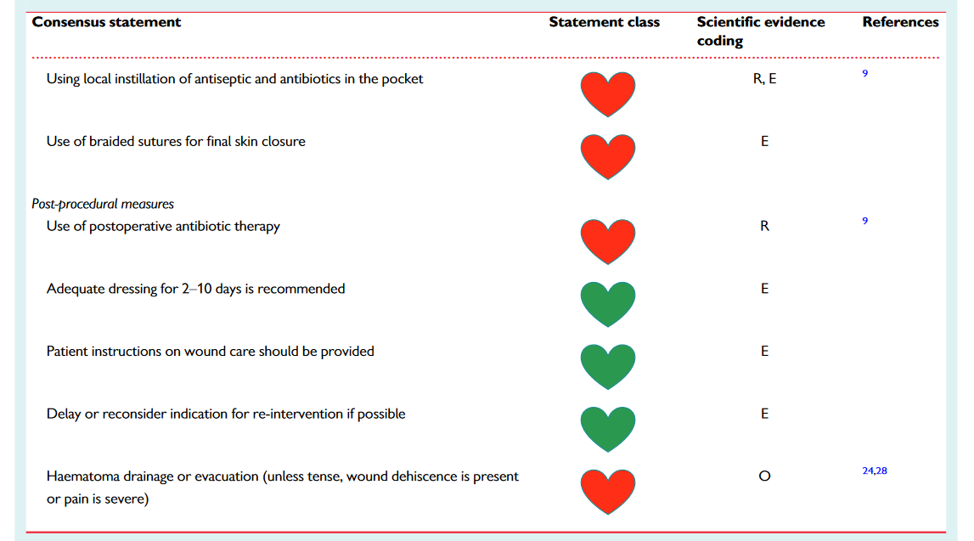
Notes:
1.VIGOROUS POCKET IRRIGATION IS RECCMNDED--. USE OF LOCAL INSTILLATION OF ANTIBIOTIC OR ANTUSEPTC IS NOT RECCMNDED
2. WOUND DEHISENCE OR SUPRFCIAL INF CAN LEAD TO FRANK POCKET INFECTION
3. CLOSURE IN LAYERS MINIMISES WOUND TENSION AND REDUCES THE RISK OF DEHISENCE AND INF
4.SKIN CLOSURE CAN BE WITH A SUBCUTICULAR ABSORBABALE SUTURE, NON ABSORBABLE SUTURE , SURGICAL STAPLER OR SURGICAL ADHESIVES
IF NON ABSORBABLE SUTURE USED IT SHOULD BE REMOVED IN TIMELY MANNER ( 7-14 DAYS)
ALTHOUGH NO DATA INDIACTING THE TYPE OF SUTURE MATERIAL IMPACTS THE RISK OF INF→ BUT MANY PREFER NON BRAIDED MONO FILAMENT SUTURES
SOME SUTURES ARE IMPREGNATED WITH ANTIBIOTICS
POCKET HEMATOMA → INCREASE RISK OF INFECTION
THERE ARE NO DATA SUPPRTING TROPICAL HEMOSTATIC AGENT
DIAGNOSTIC OR THERAPUTIC ASPIRATION OF HEMATOMA IS C/I. HEMATOMA EVACUATION SHOULD ONLY BE DOME IF PAIN MX IS UNMANAGEABLE OR WOUND CLOSURE IS THREATENED

Slide 44
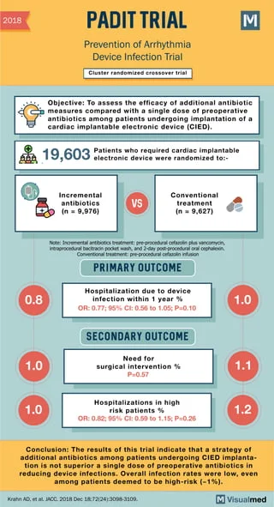

Slide 45
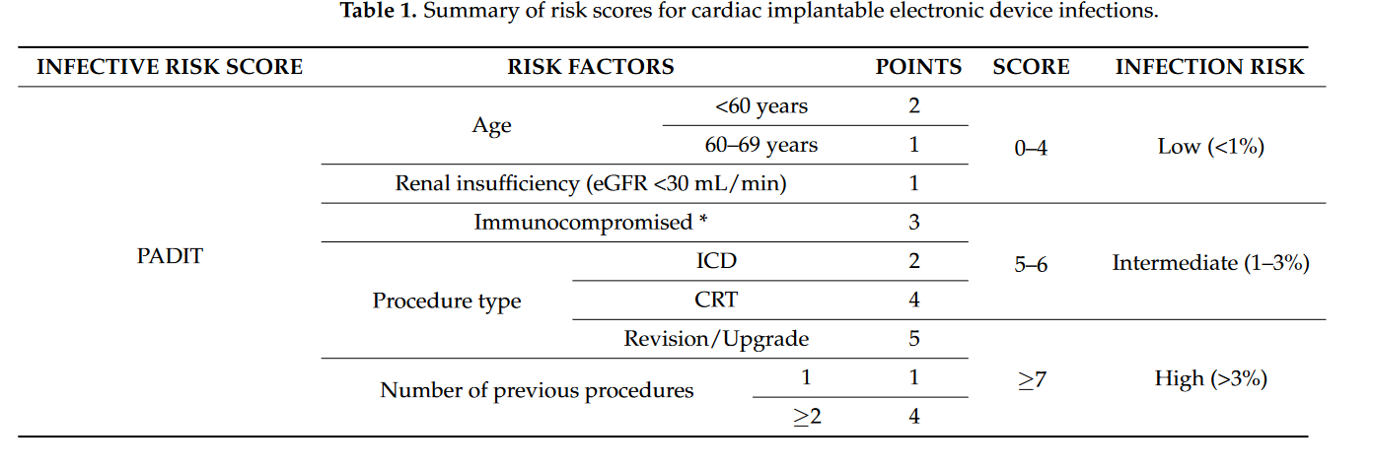

Slide 46
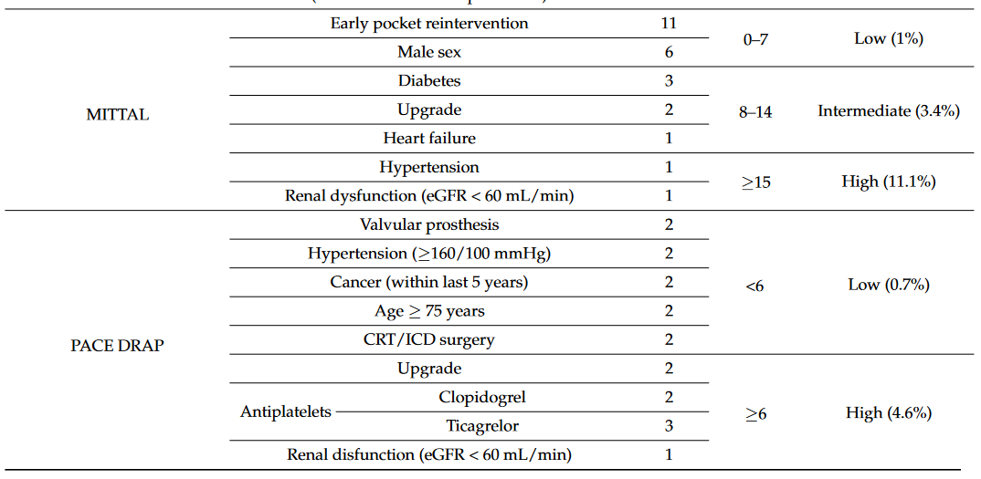
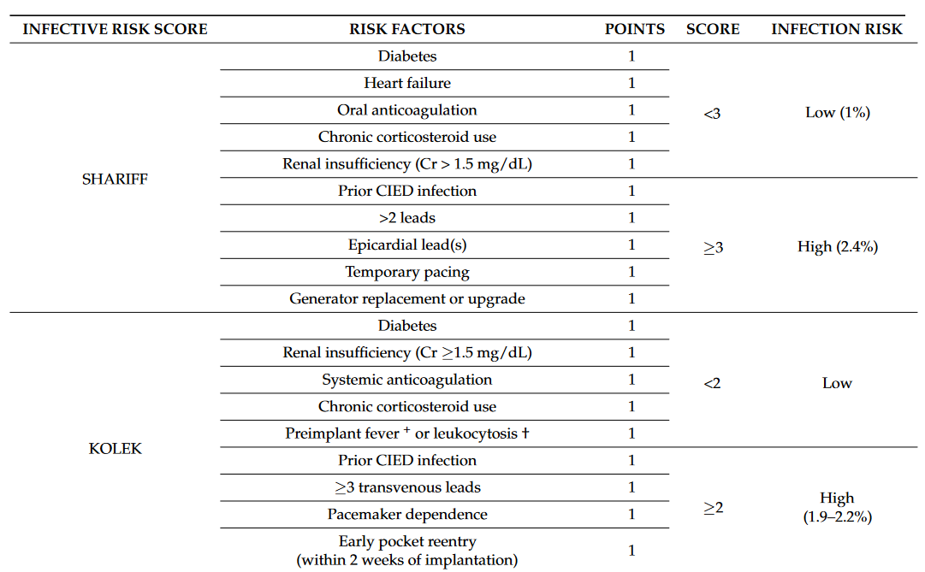

Slide 47
POST PROCEDURE MEASURES
WOUND CARE | REINTERVENTION
APPROPRIATE DRESSING SHOULD COVER THE INCISION PRESSURE DRESSING → 24 HRS NOT NECCESSARYTO CHANGE THE DRESSING → UNLESS IMPREGNATED PATIENT ADVICED TO AVOID SOAKING THE WOUND UNTILL IT HEALS | EARLY REINTERVENTION --. INCRESES RISK OF INFECTION
Notes:
HENCE ALL MEASURES MUST BE TAKEN TO AVOID THIS NEED. SOME OPERATORS DELAY REINERVNTN BY WEEKS [EG- LEAD REPOSITIONING] IN AN ATTEMPT TO REDUCE REINFECTION
THIS MAY ALSO ALLEVIATE THE PAIN ASSOC. WITH EARLY REINTRVNTN

Slide 48
CIED DEVICE AND LEAD REMOVAL
Tee demonstrating valve or lead vegetation in the presence of known or suspected bacteremia
Blood culture demonstrate isolation of
→ staphylococcus aureus
→Candida species
High grade bacteremia with following organisms : cons, cutibacterium species
Other high grade bacteremia without clear portal of entry
Presence of pocket infection with or without pocket drainage or bacteremia
Notes:
STAPH AUREUS→ [ ESPECIALLY IN THE ABSENCE OF CLEAR PORTAL OF ENTRY , AND IT IS OCCURING WITHIN THREE MONTHS OF DEVICE MANIPULATION OR PERSISTING OR RECURRING INSPITE OF ANTIMICROBIAL THERAPY//
PORTAL OF ENTRY→ESPECIALLY DUE TO ORGANISMS THAT COMMONLY CAUSE ENDOCARDITIS SUCH AS STREPTOCOCCI, ALPHA AND BETA HEMOLYTIC STREPTOCOCCI

Slide 49
Preffered approach for cied removal is → transvenous extraction of all leads in conjunction with removal of generator
Large lead vegetations more than 20 mm→ surgical removal may be warranted
Percutaneous suction removal of large lead vegetations prior to trans venous lead extraction has been used increasingly
In addition to device expandation the pocket if infected should be meticulously debraded included removal of fibrous capsule.
Notes:
1.GENERATOR→ MAJOR COMPLICATIONS R INFREQUENT ,< 2% & EXTRACTION RELATED INHOSPITAL MORTALITY < 1%
2. WARRENTED→ IN SMALL OBS STUDIES TRANSVENOUS REMOVAL OF CIED LEADS WITH LARGE VEGETATIONS WAS ASSOCIATED WITH HEMODYNAMICALLY SIGNIFICANT PULM EMBOLISM
3. FIBROUS CAPSULE→ POCKET SHOULD BE IRRIGATED WITH STERILE SALINE

Slide 50
RETENTION CRITERIA
Bacteremia due to a pathogen other than staph aureus from a defined source other than the device or valvular infection
Gnb [other than psuedomonas / serratia], pnuemococcal bacteremia , transient bacteremia due to organisms that do not commonly cause endocarditis
Presence of superficial cellulitis or stitch abcess at the incision site typically shortly after implant or generator replacement
Notes:
DEVICE RETENTION MAY BE REASONABLY ATTEMPETED IN THE FOLLOWING CIRCUMSATNCES

Slide 51
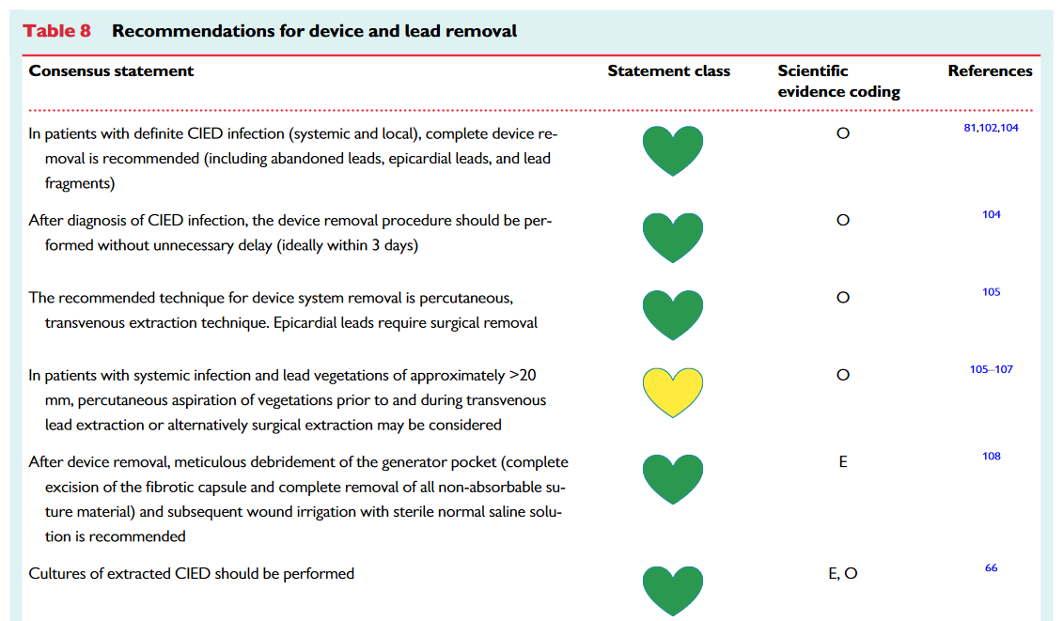

Slide 52
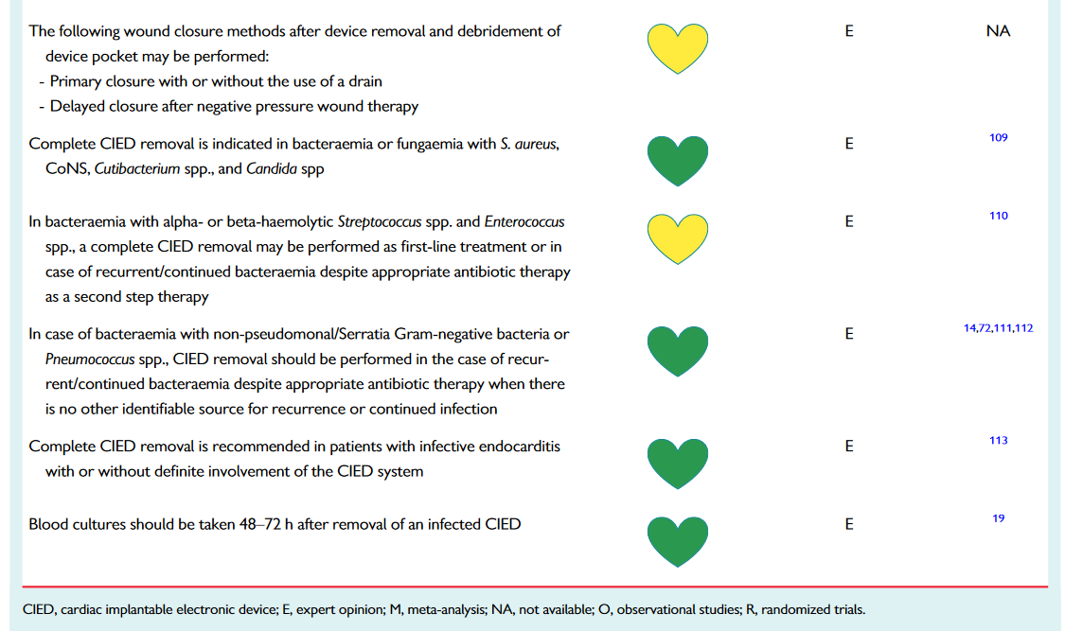

Slide 53
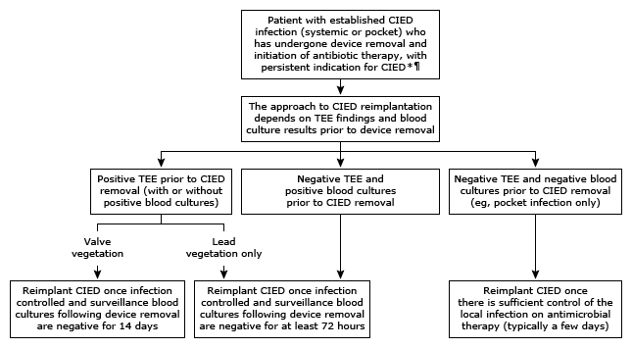
DEVICE RE IMPLANTATION
Notes:
OPTIMAL TIME FOR CIED RE IMPLTNTN IS UNCERTAIN

Slide 54
